Slide 1
WELCOME
to
Grace Amazing
Applying God’s Messages –
as delivered by Pastor Alan Wright -
Paul’s letter to the Galatians
REYNOLDA Church Ministries

Slide 2
This week’s report:
Inspiration, revelation, experience
Jesus Calling
Prayer for enlightenment from this message.

Slide 3
Sermon Series
And That’s the Gospel !
- Spies, Lies and Alibis -
Session 2
Galatians Chapter 2
REYNOLDA Church Ministries

Slide 4
The GOOD NEWS of the Gospel !
(What makes the Gospel good news?)
Nothing for you to add to the Cross of Christ
Guaranteed Inheritance.
No good thing from heaven withheld from you.
IT IS FINISHED !
NEXT SLIDE

Slide 5
Question
If nothing is withheld from me of the good things in heaven because of anything I do, does that mean that even if I continue to “fall into” my “most difficult to overcome” sin, that God does not punish me by withholding heavenly blessings ?
If no heavenly blessing is withheld, why would I think that any blessing would be?
Was Jesus punished enough?

Slide 6
Question
What does double jeopardy mean?
What does God’s word say about natural consequences – Gal 6:7 ?
Would it be JUSTICE, if once the judge agreed to let an innocent man take my punishment, that he later insisted that I should suffer that punishment as well?

Slide 7
Intensity vs Ecstasy vs Intimacy
There is a considerable difference.
Jesus’ own disciples demonstrate this:
Peter was always boisterous and intense.
John was the “beloved” disciple, quiet & close.
Judas even tried to force Jesus to be an intense and “zealous” Messiah rather than an intimate and tender Messiah!

Slide 8
Intensity, Ecstasy, Intimacy
We will come to God by way of Intensity, Ecstasy or Intimacy.
Christians commonly approach God with Intensity and believe that this is what God desires from them. We can try to find our satisfaction in being strong, heroic, and successful while using whatever weapons necessary to win a war for God in order to affect the Kingdom of God and the hearts of others. Although God desires our affection, this would be the least satisfying type of expression. Think about our own relationships. Would it be satisfying in our relationships with children if we received only servitude-type performances from our children based on fear, duty or sheer respect?

Slide 9
Intensity, Ecstasy, Intimacy
Many Christians also approach God with Ecstasy wherein we arrive in church with regular frequency to be lifted up emotionally in the presence of God and experience euphoria with God in the moment. We can really feel the draw during the week to experience it again. These ecstasies may be in the form of songs that make us rejoice, laugh, cry or otherwise express strong emotions for and with God. But once the ecstasy is over, within a very short time, usually within hours or even minutes, the ecstasy has abated and we can be easily ruled by our circumstances again or our daily routine. Then we run from ecstasy to ecstasy living like an emotional yo-yo. Many times this leaves us largely lonely for God as we inadvertently lose sight of Him and His presence with us when the ecstasy subsides in a short while.

Slide 10
Intensity, Ecstasy, Intimacy
Few Christians it seems truly experience Intimacy with God, even though most would say they desire to have it. Intimacy is the state of being fully aware and connected to God’s presence in us all day and all night. It might be described by words like belonging, inseparable, warm, loving, affectionate, familiar and comfortable. This is of course the most difficult place to find ourselves - resting in our relationship with God, since we have many things to be responsible for which end up being distractions from God. We have been raised to be self-centered (self-sufficient) and to take care of the things pertaining to our own well-being. This self-centeredness is even taught as a virtue by “owning” our part of the world or being responsible for our life.

Slide 11
Intensity, Ecstasy, Intimacy
But even though in the beginning of the journey to Intimacy with God it seems counter intuitive for us to not focus on the “details” of our lives and let God handle them, once we have practiced this way of living with God enough it will be in this place that we find the peace and rest in all circumstances that Jesus promised. It will then be as difficult for us not to think of God all the time as it was difficult in the beginning to accustom ourselves to thinking of God all the time.
The ultimate in ministry of the Kingdom of God is to reach that point in our experience with God where we can actually resonate with Jesus’ words: “Come unto me, all you who labor and are heavy laden and I will give you rest, for My yoke is easy and My burden is light.” Yet most of us have never learned to appropriate these truths in our daily experience of God.

Slide 12
Intensity, Ecstasy, Intimacy
When Intimacy with God is experienced, we will be able to express our intimate, passionate affection for God with Intensity or Ecstasy or both. The reason Intimacy is the ultimate experience of God is that when either the Intensity or Ecstasy subsides, we remain so fully aware of God’s love and presence with us that we no longer have the same desire toward sinful behaviors and broken relationships in order to escape our insecurity. In other words, Intimacy with God provides a constant supply of Love, Acceptance, Worth, and Security from the one that created us with these needs in the first place. Since it is always the lack of one or more of these basic needs that sends us into sinful behaviors and broken relationships, finding ourselves to be fully loved and our needs fully met in Christ will provide the life source to live above sin’s power.

Slide 13
The GOOD NEWS of the Gospel!
(Why did Jesus come?)
Never wanted us to be separated from Him
Never wanted us to be orphans
Always had intended for us to enjoy fellowship with Him
RECKONED BY GOD THROUGH JESUS as if you were RIGHTEOUS LIKE JESUS
NEXT SLIDE

Slide 14
Question
What is “justification” ?
If I am justified the moment I confess Jesus Christ as Lord, and all of my sins (past, present and future) are covered by THAT REPENTANCE, then how can God hold any sin against me once I have been “saved” ?
Is salvation a “once saved, always saved” event ?
Notes:
Some say that justification is being made “JUST-as IF- I’D” NEVER SINNED.
we can’t forget or let go of a wrong done to us, but God can and does.
God does NOT FORGET, but He removes sin from us as far as East is from West.
Another way to define JUSTIFICATION is that
I have received the righteousness of Christ by IMPUTATION, just as Abraham
(This was Martin Luther’s argument with the Catholic Church.)
If I am justified the moment I confess Jesus Christ as Lord,
and all of my sins (past, present and future) are covered by THAT REPENTANCE,
then how can God hold any sin against me after I have received
the righteousness of Christ, by IMPUTATION? Martin Luther’s argument

Slide 15
It was Canon Holmes, of India, who more than twenty-five years ago called attention to the inferential character of the average man's faith in God. To most people God is an inference, not a reality. He is a deduction form the evidence which they consider adequate; but He remains personally unknown to the individual. "He must be," they say, "therefore we believe He is." Others do not go even so far as this; they know of Him only by hearsay. They have never bothered to think the matter out for themselves, but have heard about Him from others, and have put belief in Him into the back of their minds along with the various odds and ends that make up their total creed. To many others God is but an ideal, another name for goodness, or beauty, or truth; or He is law, or life, or the creative impulse back of the phenomena of existence.
Tim Keller - Pastor in Manhattan
Tim, a personal friend of our Pastor Alan, wrote in one of his books the following:
1 John 1:9 declares that when we confess our sins to God for salvation, God has no choice other than to forgive them and to cleanse us from “all” unrighteousness. His Justice demands that since He allowed His own innocent Son, Jesus, to become the substitute regarding the punishment of any and every person who believes in Jesus and accepts Christ’s substitution in that regard, He cannot then also punish any who have accepted this offer on the part of Jesus Christ.

Slide 16
The GOOD NEWS of the Gospel!
(simple and pure)
The GOSPEL is simple and pure
There is nothing to “add to” the GOSPEL
There is a subtle message ?from Hell?: “you must add something to it” “the GOSPEL can’t be that simple”
So we worry about it and we are robbed of the GOSPEL’S power
NEXT SLIDE

Slide 17
Question
If I do NOT, as a Christian, confess my sins in order to be forgiven and cleansed from all unrighteousness, what then?
If 1 John Chapter 1 is not about Christians being required to go to confession, what is it about ?
If 1 John Chapter 1 does indeed direct us as Christians to confess our sins for forgiveness and cleansing, what sins are not covered by my salvation ?
Notes:
1 John Chapter 1, as it proclaims within itself was written to tell the world (both unbelievers
and believers) how we KNOW THAT WE ARE SAVED !
This is confirmed by the fact that every JUSTICE system in history
does NOT endorse double jeopardy.
The uniqueness of the satisfaction of JUSTICE with respect to our salvation is that
God applies concurrent sentence of “separation” upon all of the sins of our entire lifetime
in one hearing, that being when Jesus as our advocate becomes our substitute by our confession
Any and all subsequent confessions for forgiveness are not entertained or even heard by the court.
This widely held view that we need to confess our sins as Christians does not meet the tests of
1 –Justice
2 - One consequence for ALL sins for all men of all time
3 – Scriptures which teach that we cannot crucify Christ again and again
4 – The doctrine of Eternal Security
5 – Sins do not separate any one from God, only the rejection of the Blood of Christ does

Slide 18
The GOOD NEWS of the Gospel!
(peace or not peace, that is the question)
“Peace, peace.” spoken to unbelieving world where there is no peace
False message: “Don’t worry; no problems.”
“Unrest, unrest,” to those who have already received the peace of Christ.
False message among believers: “You need to do something to amend the GOSPEL such that you can experience peace.”
NEXT SLIDE

Slide 19
Question
First of all, does the unrest only come as a message from Hell or are we NOT at REST because our circumstances overwhelm us?
What are the things in your life that cause you to worry, or be afraid ?
What is it that we DO NOT BELIEVE that lets us continue to be stressed out and fearful ?
Notes:
1 John Chapter 1, as it proclaims within itself was written to tell the world (both unbelievers
and believers) how we KNOW THAT WE ARE SAVED !
This is confirmed by the fact that every JUSTICE system in history
does NOT endorse double jeopardy.
The uniqueness of the satisfaction of JUSTICE with respect to our salvation is that
God applies concurrent sentence of “separation” upon all of the sins of our entire lifetime
in one hearing, that being when Jesus as our advocate becomes our substitute by our confession
Any and all subsequent confessions for forgiveness are not entertained or even heard by the court.
This widely held view that we need to confess our sins as Christians does not meet the tests of
1 –Justice
2 - One consequence for ALL sins for all men of all time
3 – Scriptures which teach that we cannot crucify Christ again and again
4 – The doctrine of Eternal Security
5 – Sins do not separate any one from God, only the rejection of the Blood of Christ does

Slide 20
The GOOD NEWS of the Gospel!
(what on earth happened in the Garden anyway)
perfect dwelling, perfect blessing, perfect fellowship
No shame -- Complete Freedom
Satan’s lie: You must DO to BE “blessed.”
as soon as they believed that they had to do something in order to be blessed more fully, they lost the blessing they already knew
NEXT SLIDE

Slide 21
One way to look at the Gospel is to see the story of “making man in God’s own image” like this:
God wanted to expand the circle of love, joy and peace experienced by the Father, Son and Holy Spirit to include more beings. In order for that to occur, God had to create beings with the potential capacity to be included in the trinity (which would obviously expand exponentially as the creatures made “in His image” with such potential voluntarily joined that unity (trinity) by personal invitation by the Son to be married and joined in that union with Christ.
So, God, created Adam with that potential and actually with the Spirit of God within Him (kind of like a Christian received that Spirit of God at salvation) to eventually be exactly like Jesus when Adam would see Jesus up close and personal in heaven after he died.

Slide 22
When Adam became lonely, God put him to sleep and took one of his ribs from which God made Eve. All was well until Eve was deceived by Satan through the Serpent and she ate of the fruit of rebellion which resulted in her divorce of the Holy Spirit which Spirit left her heart upon eating the fruit. (God had told Adam that he could eat of every tree in the Garden of Eden except that one. If he ate of the fruit of that tree, he would surely die.) Obviously, when even came to Adam and showed him that not only had she eaten the forbidden fruit, but also that she had certainly not died. Adam was then faced with the choice to believe God or believe his wife. He with full awareness of his choice believed his wife over God and ate of the fruit of rebellion (like Satan and the war in heaven) which resulted in Adam’s divorce fo the Holy Spirit as well. Eve was deceived, but Adam knowingly rebelled.

Slide 23
Now it stands the test of reason, that since Adam and Eve did not physically die, that the Spirit of God died to them leaving them with only their own human spirits.
All of this was part of God’s grand plan to bring every human being to the state of being with only a human spirit within them. Thus the fall of the Garden was an essential part of God Master Plan to expand the trinity.
As the scriptures say, that in Adam, all mankind was left devoid of God’s Holy Spirit after he sinned. And as the scriptures say of Jesus, through Him the Holy Spirit of God becomes reunited with the spirit of any and every man who responds to the Divine Invitation of Jesus to be His bride and fully surrendered as a bride to her groom in that marriage.

Slide 24
As our husband, Jesus is not only our LORD, but also our provider and a dandy provider at that. Once we have been joined to Christ in this marriage, we are complete again as in the Garden. We become full heirs of God’s Inheritance. And when we die physically and our spirit departs our body, our spirit in union with the Holy Spirit once in the very presence of Christ becomes part of the unity (trinity) as planned from the beginning.
That is why John Chapter 1 declares that “in the beginning was the Word and the Word was with God and the Word was God. The same was in the beginning with God. Without Him was not anything made …” Thus, the separation from God which is the penalty of our relational crimes (divorces) is resolved by voluntary surrender in love in response to God’s love.

Slide 25
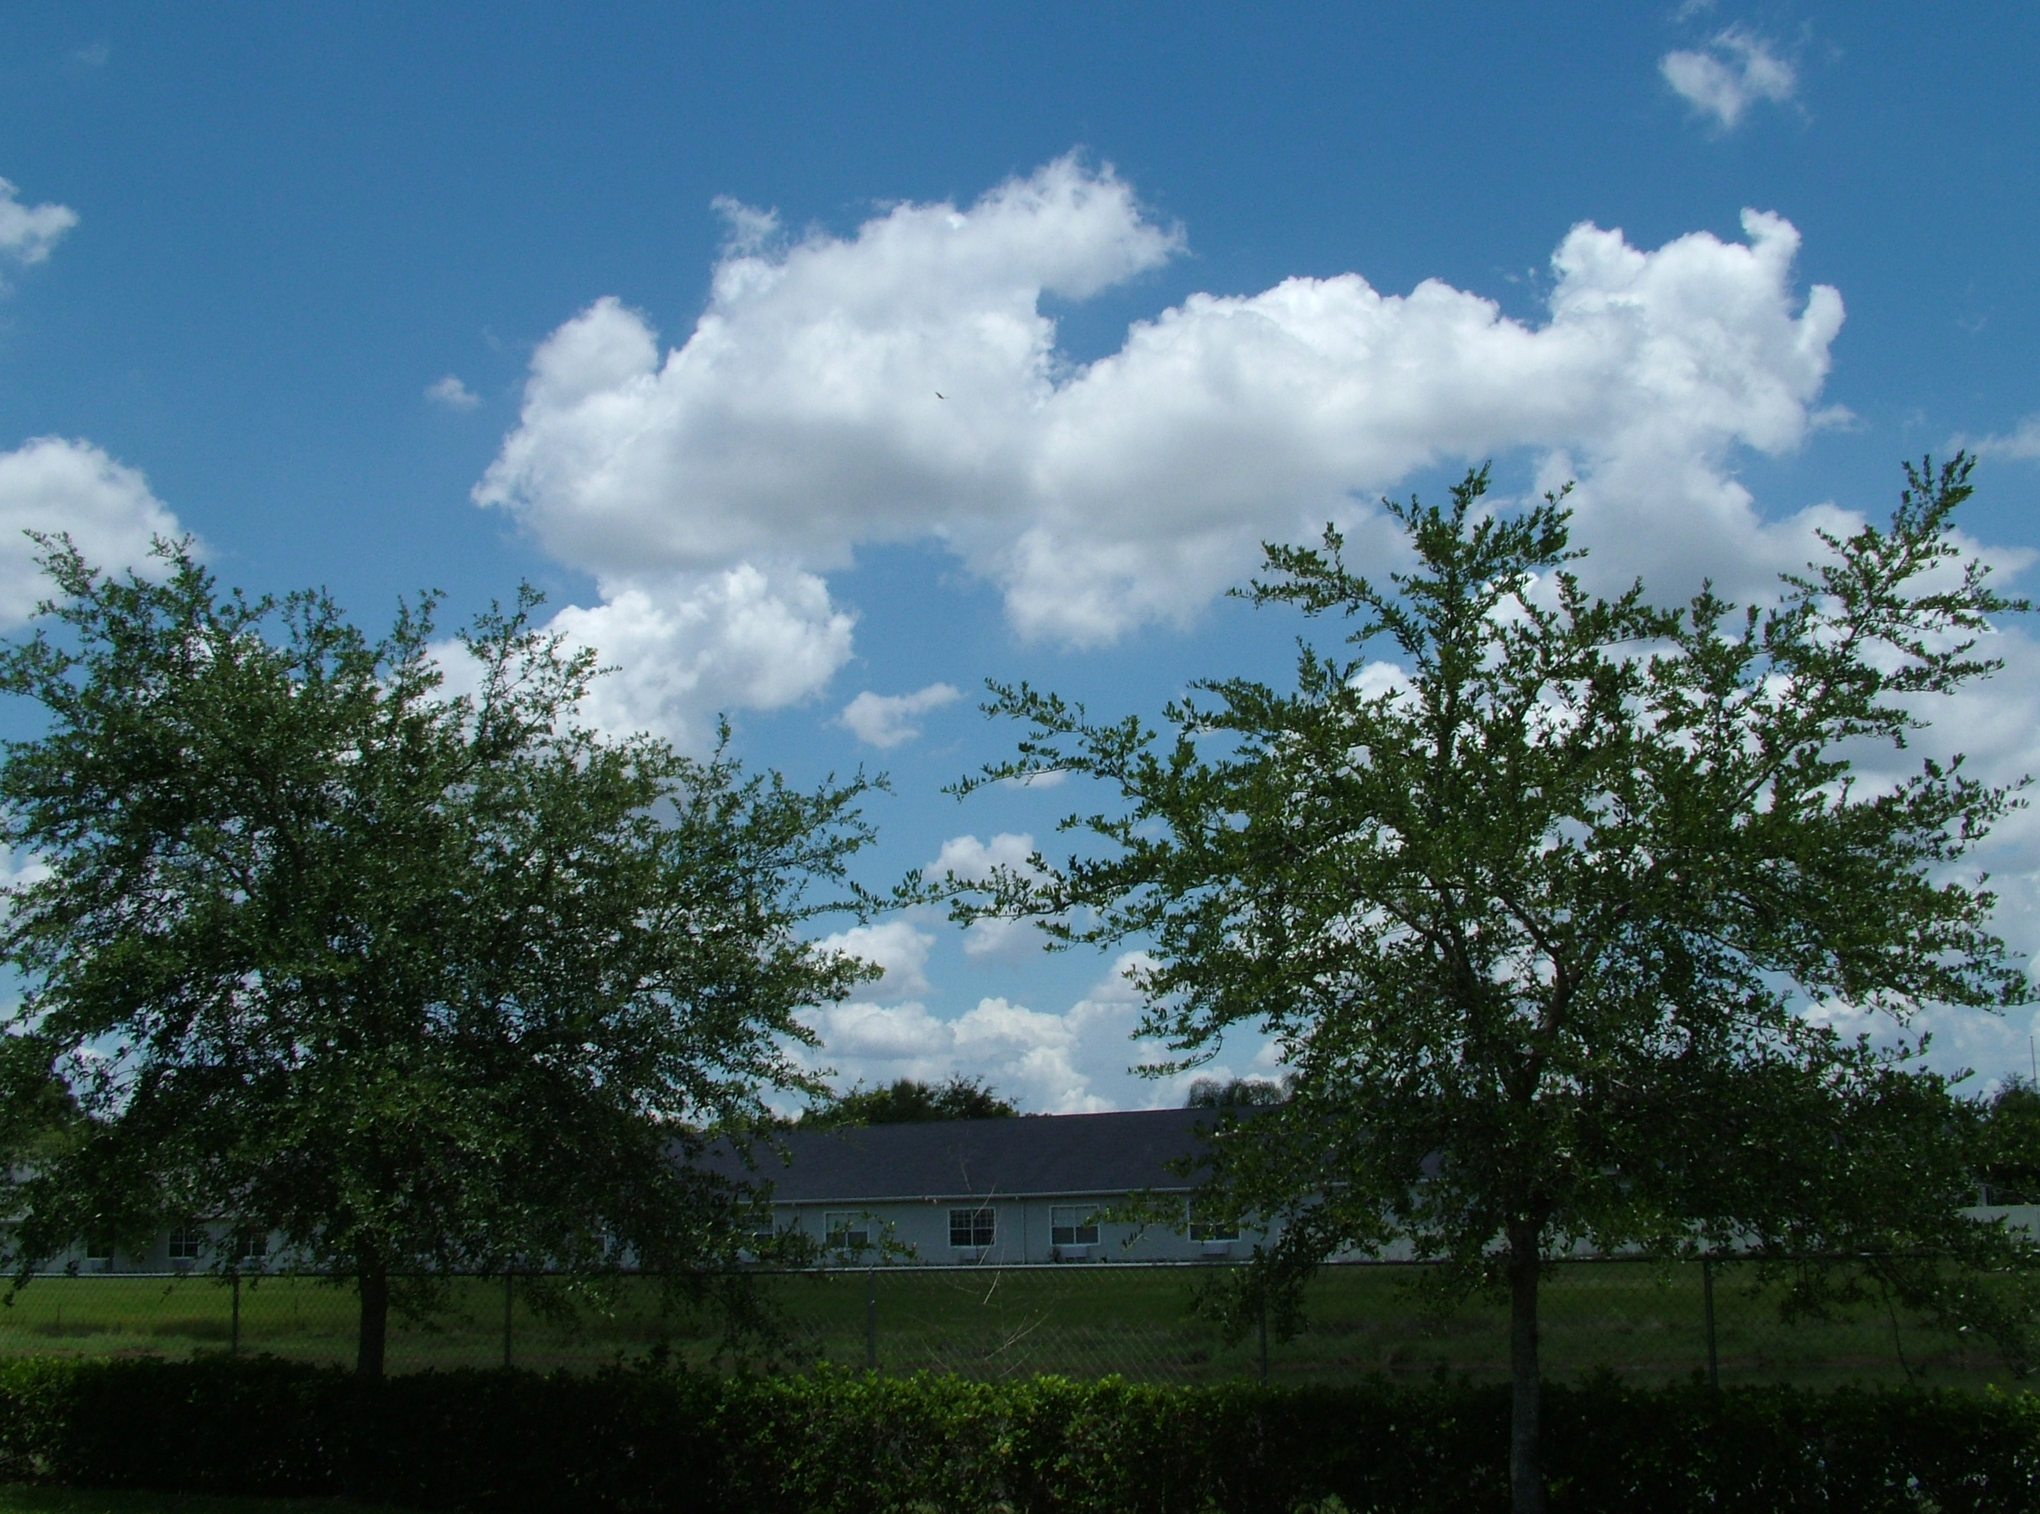
The Biblical Origin of Knowledge . . .
The Two Trees
Genesis 2:9
And out of the ground the LORD God caused to grow every tree that is pleasing to the sight and good for food; the tree of life also in the midst of the garden, and the tree of the knowledge of good and evil. (NASB)
The Tree of Knowledge of
Good and Evil
The Tree of
Life
Genesis 2:9

Slide 26
Which tree are you eating from?
The Biblical Origin . . .
Good & Evil
Life
Self-Sufficiency (flesh)
Christ-Sufficiency (SPIRIT)
Independence
Dependence
Bondage
Freedom
Law
Grace
Death (Relational)
Life (Relational)
DO to BE
BE to DO
Flesh is self-centered, self-sufficient,
and self-reliant.
Spirit is Christ-centered, Christ-sufficient,
and Christ-reliant.

Slide 27
Which tree are you eating from?
The Biblical Origin . . .
Good & Evil
Life
Self-Sufficiency (flesh)
Christ-Sufficiency (SPIRIT)
Independence
Dependence
Bondage
Freedom
Law
Grace
Death (Relational)
Life (Relational)
DO to BE
BE to DO
self-indulgent = give me, self-promoting = see me , self-sovereign = serve me.
Other centered = give you, see you, serve you.

Slide 28
Significance of the trees:
Every religion in every age has promoted good behavior and discouraged bad behavior. All religions except Christianity teach that if your “good is greater than your bad,” you will achieve eternal life. The point of commonality between religion and Christianity is that ALL MEN KNOW WHAT IS GOOD AND WHAT IS EVIL BECAUSE OF THEIR HAVING EATEN FROM THE TREE OF KNOWLEDGE (IN ADAM).
This is not to say that Christians should devalue good behavior. However, Christ made it clear that the way to eternal life is faith in Him alone and God’s reconciliation of mankind through the satisfaction of His justice by and through His Son, Jesus and His Son ALONE!

Slide 29
Significance of the trees:
The unique opportunity we have IN CHRIST is: The Spirit of Christ comes into us (new creation) and it is His Spirit and His Spirit alone that can live the “perfect” Christian life as clearly stated by Paul in Galatians 2:20.
When Christians focus on their diet of fruit from the tree of knowledge instead of feasting on the fruit of the tree of life, we miss that which makes Christianity unique. We believe in the indwelling presence of Christ! And it is His life alone that is imputed to us as righteousness!

Slide 30
Knowledge of Good and Evil
Now that you are a Christian, you should know better and do better.
What’s wrong with this statement?
Every man (in Adam) is born with the knowledge of good and evil !
Being born again has nothing to do with enlightening a person about right or wrong !

Slide 31
Knowledge of Good and Evil
What do all religions (other than Christianity) proclaim as the means of their eternal salvation (well-being) ?
Isn’t it interesting how many Christians run to and fro buying books that tell them how to be more like God, all of which “add to” the Gospel. Either Jesus did it all and He gives us everything or He does nothing for us at all.
No wonder Adam and Eve fell into this trap. Haven’t we all?

Slide 32
Amazing Grace Plus
Amazing Grace? That's hardly sound! God's love is hardly free. When I was lost, my way I found So much depends on me!
If grace is raised up far too high My heart may lose its fear Without that fear, I may slack off Then how will I be steered?

Slide 33
Amazing Grace Plus
Sure God has promised good to me His word my hopes secure But shields & portions don't come cheap And life's costs still endure
When we've been there 10,000 years Bright shining as the sun, The works we've done will fuel that sun, Our shields serve as our mirror!

Slide 34
Amazing Grace Plus
Amazing Grace? That's hardly sound! God's love is hardly free. When I was lost, my way I found So much depends on me!
(with apologies to John Newton) (c) 2013 Barton J Breen

Slide 35
Galatians 2:1-5
Then after fourteen years I went up again to Jerusalem with Barnabas, taking Titus along with me. 2 I went up because of a revelation and set before them (though privately before those who seemed influential) the gospel that I proclaim among the Gentiles, in order to make sure I was not running or had not run in vain. 3 But even Titus, who was with me, was not forced to be circumcised, though he was a Greek. 4 Yet because of false brothers secretly brought in--who slipped in to spy out our freedom that we have in Christ Jesus, so that they might bring us into slavery-- 5 to them we did not yield in submission even for a moment, so that the truth of the gospel might be preserved for you.

Slide 36
Galatians 2:6-10
And from those who seemed to be influential (what they were makes no difference to me; God shows no partiality)--those, I say, who seemed influential added nothing to me. 7 On the contrary, when they saw that I had been entrusted with the gospel to the uncircumcised, just as Peter had been entrusted with the gospel to the circumcised 8 (for he who worked through Peter for his apostolic ministry to the circumcised worked also through me for mine to the Gentiles), 9 and when James and Cephas and John, who seemed to be pillars, perceived the grace that was given to me, they gave the right hand of fellowship to Barnabas and me, that we should go to the Gentiles and they to the circumcised. 10 Only, they asked us to remember the poor, the very thing I was eager to do.

Slide 37
The GOOD NEWS of the Gospel!
(summarized)
Revelation from God Paul ordered to Go Extremely Important Face to Face
Agreement not to combine LAW with GRACE
Undermining the message by Undermining credibility of the messenger by Denigrating character and / or Questioning credentials
ENORMOUS PRESSURE TO CONFORM
NEXT SLIDE

Slide 38
Question
When someone gives us a message, which they claim is from God, and we don’t want to believe it, how do we rationalize the message away?
Undermining the message by Undermining credibility of the messenger by Denigrating character and / or Questioning credentials
What examples do we have in scripture that the messenger’s integrity has nothing to do with the authority of the Word of the Lord ?
Notes:
1 John Chapter 1, as it proclaims within itself was written to tell the world (both unbelievers
and believers) how we KNOW THAT WE ARE SAVED !
This is confirmed by the fact that every JUSTICE system in history
does NOT endorse double jeopardy.
The uniqueness of the satisfaction of JUSTICE with respect to our salvation is that
God applies concurrent sentence of “separation” upon all of the sins of our entire lifetime
in one hearing, that being when Jesus as our advocate becomes our substitute by our confession
Any and all subsequent confessions for forgiveness are not entertained or even heard by the court.
This widely held view that we need to confess our sins as Christians does not meet the tests of
1 –Justice
2 - One consequence for ALL sins for all men of all time
3 – Scriptures which teach that we cannot crucify Christ again and again
4 – The doctrine of Eternal Security
5 – Sins do not separate any one from God, only the rejection of the Blood of Christ does

Slide 39
Question
How is the church today affected by pressure to conform with the majority point of view?
Why is there so much pressure not to ask questions or not to give answers that are not in the mainstream of our churches doctrinal viewpoints?
What examples do we have in scripture that Jesus was at odds with the religious leaders of His own religion?
Notes:
1 John Chapter 1, as it proclaims within itself was written to tell the world (both unbelievers
and believers) how we KNOW THAT WE ARE SAVED !
This is confirmed by the fact that every JUSTICE system in history
does NOT endorse double jeopardy.
The uniqueness of the satisfaction of JUSTICE with respect to our salvation is that
God applies concurrent sentence of “separation” upon all of the sins of our entire lifetime
in one hearing, that being when Jesus as our advocate becomes our substitute by our confession
Any and all subsequent confessions for forgiveness are not entertained or even heard by the court.
This widely held view that we need to confess our sins as Christians does not meet the tests of
1 –Justice
2 - One consequence for ALL sins for all men of all time
3 – Scriptures which teach that we cannot crucify Christ again and again
4 – The doctrine of Eternal Security
5 – Sins do not separate any one from God, only the rejection of the Blood of Christ does

Slide 40
The GOOD NEWS of the Gospel!
(recognizing spies)
be sure you recognize the spies
personal opinion or the Bible
not a sin, an issue of conscience
Temple of the Holy Spirit
NEXT SLIDE

Slide 41
Question
What are some things that are considered sin by one group of Christians but not by other groups?
smoking drinking dancing caffeine
What is the significance of the statement: “your body is the Temple of the Holy Spirit.” ?
Notes:
1 John Chapter 1, as it proclaims within itself was written to tell the world (both unbelievers
and believers) how we KNOW THAT WE ARE SAVED !
This is confirmed by the fact that every JUSTICE system in history
does NOT endorse double jeopardy.
The uniqueness of the satisfaction of JUSTICE with respect to our salvation is that
God applies concurrent sentence of “separation” upon all of the sins of our entire lifetime
in one hearing, that being when Jesus as our advocate becomes our substitute by our confession
Any and all subsequent confessions for forgiveness are not entertained or even heard by the court.
This widely held view that we need to confess our sins as Christians does not meet the tests of
1 –Justice
2 - One consequence for ALL sins for all men of all time
3 – Scriptures which teach that we cannot crucify Christ again and again
4 – The doctrine of Eternal Security
5 – Sins do not separate any one from God, only the rejection of the Blood of Christ does

Slide 42
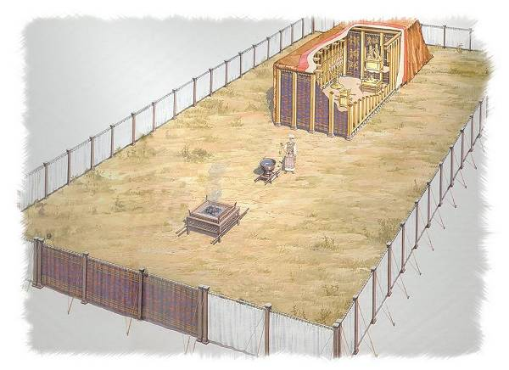
The Tabernacle
Holy
of
Holies
Holy Place
Outer Court
My body, the temple of the H.S.: body = outer tent; mind = outer court . soul = Holy Place; spirit = Holy of Holies

Slide 43
Questions
What is going on in your Holy of Holies?
What is your motive for making choices?
Is your current “expression” consistent with an intimate relationship with God which is characterized by death to self (sacrifice)?
Notes:
1 John Chapter 1, as it proclaims within itself was written to tell the world (both unbelievers
and believers) how we KNOW THAT WE ARE SAVED !
This is confirmed by the fact that every JUSTICE system in history
does NOT endorse double jeopardy.
The uniqueness of the satisfaction of JUSTICE with respect to our salvation is that
God applies concurrent sentence of “separation” upon all of the sins of our entire lifetime
in one hearing, that being when Jesus as our advocate becomes our substitute by our confession
Any and all subsequent confessions for forgiveness are not entertained or even heard by the court.
This widely held view that we need to confess our sins as Christians does not meet the tests of
1 –Justice
2 - One consequence for ALL sins for all men of all time
3 – Scriptures which teach that we cannot crucify Christ again and again
4 – The doctrine of Eternal Security
5 – Sins do not separate any one from God, only the rejection of the Blood of Christ does

Slide 44
The GOOD NEWS of the Gospel!
(importance of this issue of circumcision)
sign of the old covenant
given to abraham & jews
“God said”
twisting God’s Word (words)
NEXT SLIDE

Slide 45
Biblical reasons why Old Covenant does not apply to our church today
Since circumcision does not apply to us, as it is the sign of, and means of inclusion in, the Old Covenant, we are included in neither.
Jesus proclaimed that He had fulfilled the Old Covenant (LAW). The provisions and requirements of a completed contract are no longer in effect and do not apply to any other contract.
The New Covenant is based on a GIFT of grace not a REWARD for obedience to law.
Notes:
1 John Chapter 1, as it proclaims within itself was written to tell the world (both unbelievers
and believers) how we KNOW THAT WE ARE SAVED !
This is confirmed by the fact that every JUSTICE system in history
does NOT endorse double jeopardy.
The uniqueness of the satisfaction of JUSTICE with respect to our salvation is that
God applies concurrent sentence of “separation” upon all of the sins of our entire lifetime
in one hearing, that being when Jesus as our advocate becomes our substitute by our confession
Any and all subsequent confessions for forgiveness are not entertained or even heard by the court.
This widely held view that we need to confess our sins as Christians does not meet the tests of
1 –Justice
2 - One consequence for ALL sins for all men of all time
3 – Scriptures which teach that we cannot crucify Christ again and again
4 – The doctrine of Eternal Security
5 – Sins do not separate any one from God, only the rejection of the Blood of Christ does

Slide 46
Wrapping it up
Ponder for a while
What is the only command of Jesus?
Why would Jesus tell the adulteress at His feet to “sin no more,” knowing that no one lives a sinless life on earth?
Why do so many Christians try so hard to obey the 10 commands, while hating those who totally disregard them, either as unbelievers or as believers in “cheap” grace?
Why do Christians do “loving” things for people they actually hate or strongly dislike?

Slide 47
Assignment for next week:
continue using Jesus Calling daily
be aware of others’ anguish or joy
Take note of anything that brings new inspiration or revelation.
Be prepared to share them with us.

Slide 48
Anyone feel God’s Spirit is urging
you to pray before we dismiss?

